Slide 1

Marimagang.com as Media
for Seeking Internship Place and Student Monitoring
Made By
Glasses Team
Indonesia Computer University
Faculty of Engineering and Computer Science
Informatics Engineering

Slide 2

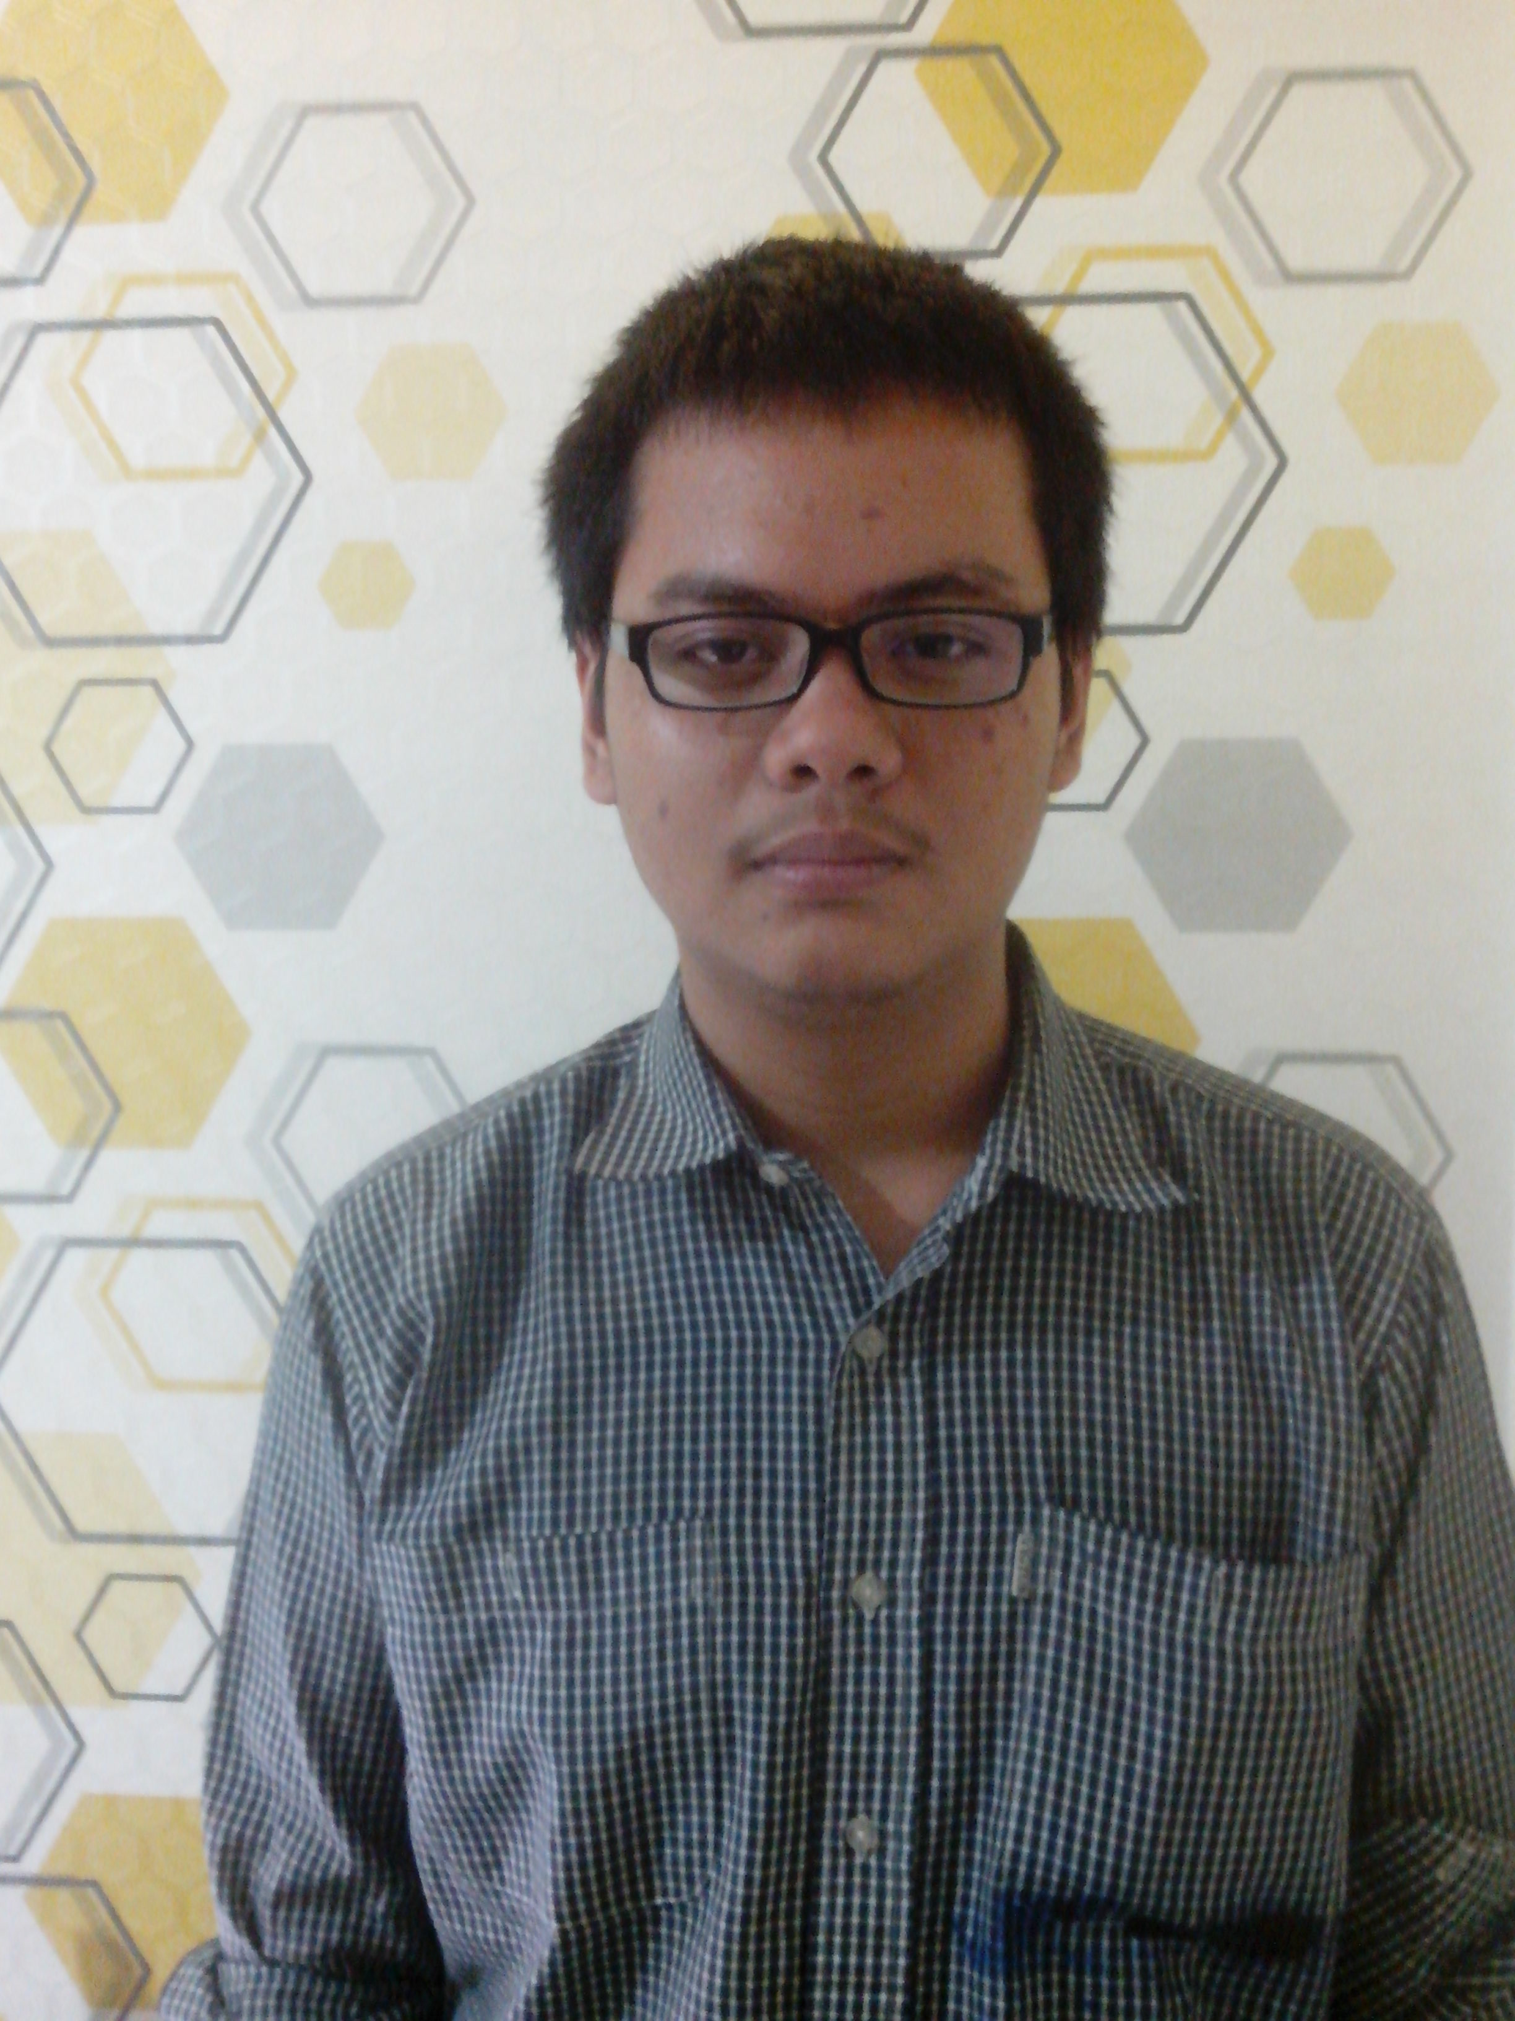




Glasses Team
Ismail Zakky
Andrew Toy
Ahmad Paudji H.S
Handoyo
Wupi Ocktavia

Slide 3

4.8 Billion
Every year many students need to get internship

Slide 4

131 thousand
Indonesia has a lot of state and private companies

Slide 5

Anyone can help me to find
internship place ?

Slide 6

Is there any tools which can help me for monitoring & controlling my student ?

Slide 7


Here is solution for you ….

Slide 8




Employer
Apps User
Student
Administrator
Visitor

Slide 9
Apps Functionality

Slide 10
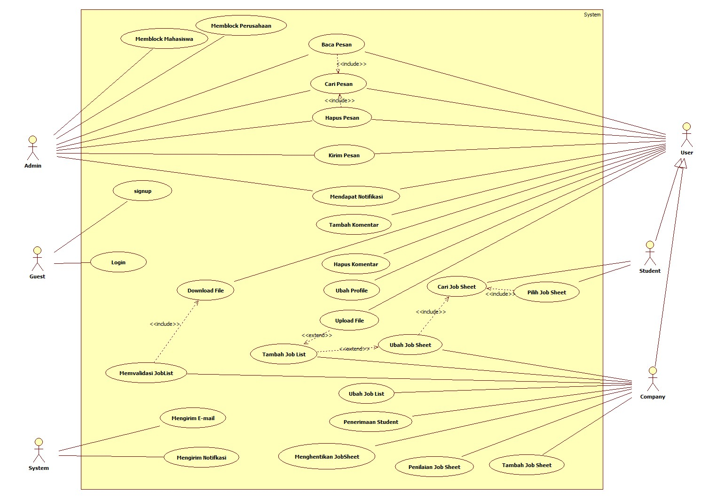
Process Model
(Use Case)

Slide 11
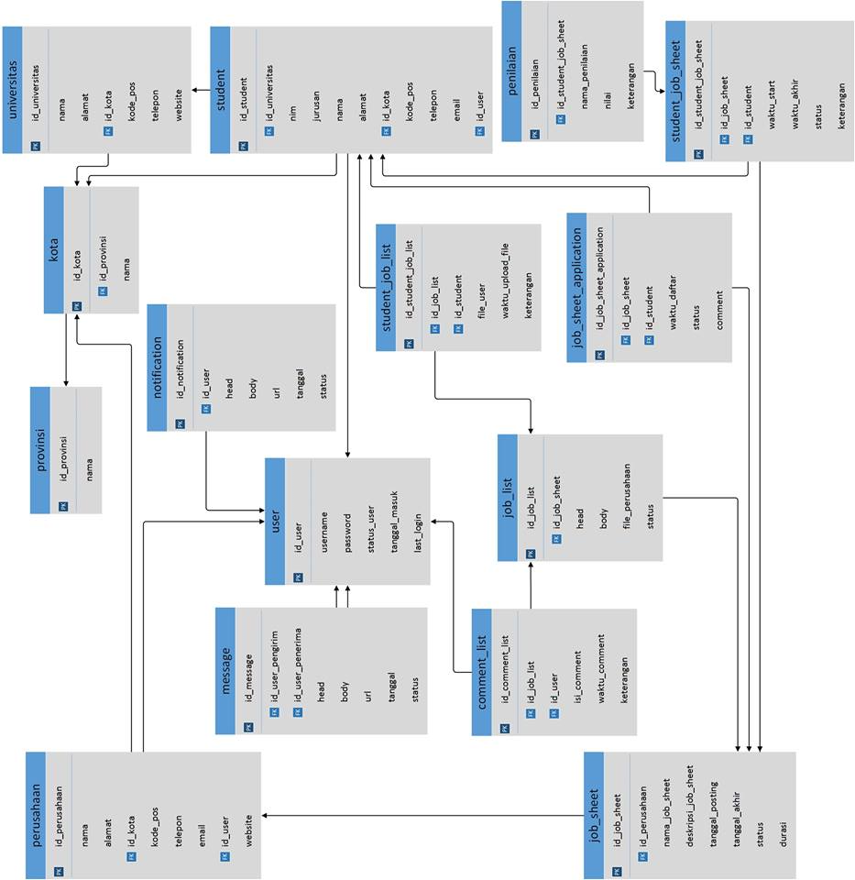
Data Model
(Relation Scheme)

Slide 12

Apps DEMO
www.marimagang.com

Slide 13
Thanks For Your Attention…
Success start from 99% of effort and 1% of luck
--Albert Einstein--

